Slide 1
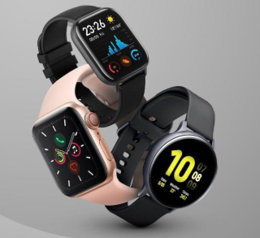
SMARTWATCH SENTIMENT ANALYZER

Slide 2
GROUP MEMBERS:
Thavanesh Krishna - AP23110010619
Murali Krishna - AP23110010656
Harshavardhini - AP23110011144
Mahasvin - AP23110010075
B.Saicharan - AP23110010173

Slide 3
PROBLEM STATEMENT & OBJECTIVES
Problem Statement:
Salesforce SmartBridge Company wants a simple and efficient way to understand customer opinions from smartwatch reviews. Since reviews often contain mixed or unclear feedback, the company needs a tool that can automatically identify whether a review is positive, negative, or neutral. The goal is to identify customer sentiment and improve product development.
Objectives:
Develop a user-friendly sentiment analysis tool
Automatically classify customer reviews into Positive, Negative, or Neutral
Help the company gather actionable insights
Improve product development based on customer feedback

Slide 4
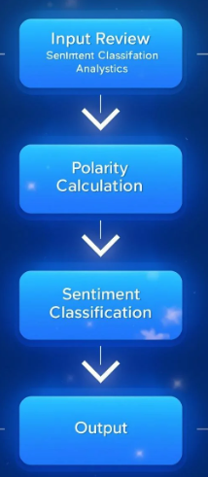
PROPOSED SOLUTION & WORKFLOW
Streamlit Web App for Real-Time Sentiment Analysis
A lightweight Streamlit web application that analyzes customer review text using the TextBlob sentiment polarity method.
Workflow:
User enters a smartwatch review
App extracts text input
TextBlob calculates polarity score (−1 to +1)
Polarity → Sentiment category
Sentiment displayed to the user

Slide 5
DATASET & METHADOLOGY
Dataset:
Smartwatch_genai.csv(1,597+ customer reviews)
This dataset provides 27 features, including product brand, categories, dimensions-allowing both product-level and review-level analysis.
The dataset includes detailed review texts, ratings, and titles, making it suitable for sentiment analysis, opinion mining, and customer feedback analytics for smartwatch products.
Methodology:
Classical ML Models
Logistic Regression, Random Forest, SVM, etc.
Result: <50% accuracy
Apply TextBlob sentiment polarity
Polarity > 0 → Positive
Polarity < 0 → Negative
Polarity = 0 → Neutral

Slide 6
TECHNOLOGIES USED
Streamlit
Streamlit enables rapid development of interactive web applications.
TextBlob
Used for:
Sentiment polarity calculation
Sentence detection
Classification into positive/negative/neutral.
Python
Python is a versatile programming language for data analysis.
VS Code
Integrated Development Environments streamline coding and debugging processes.

Slide 7
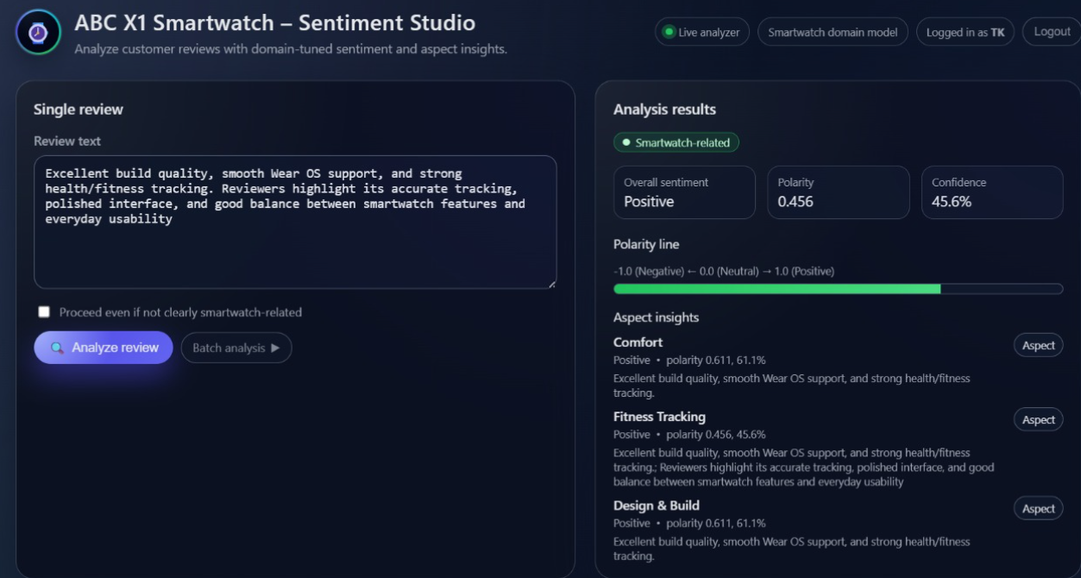
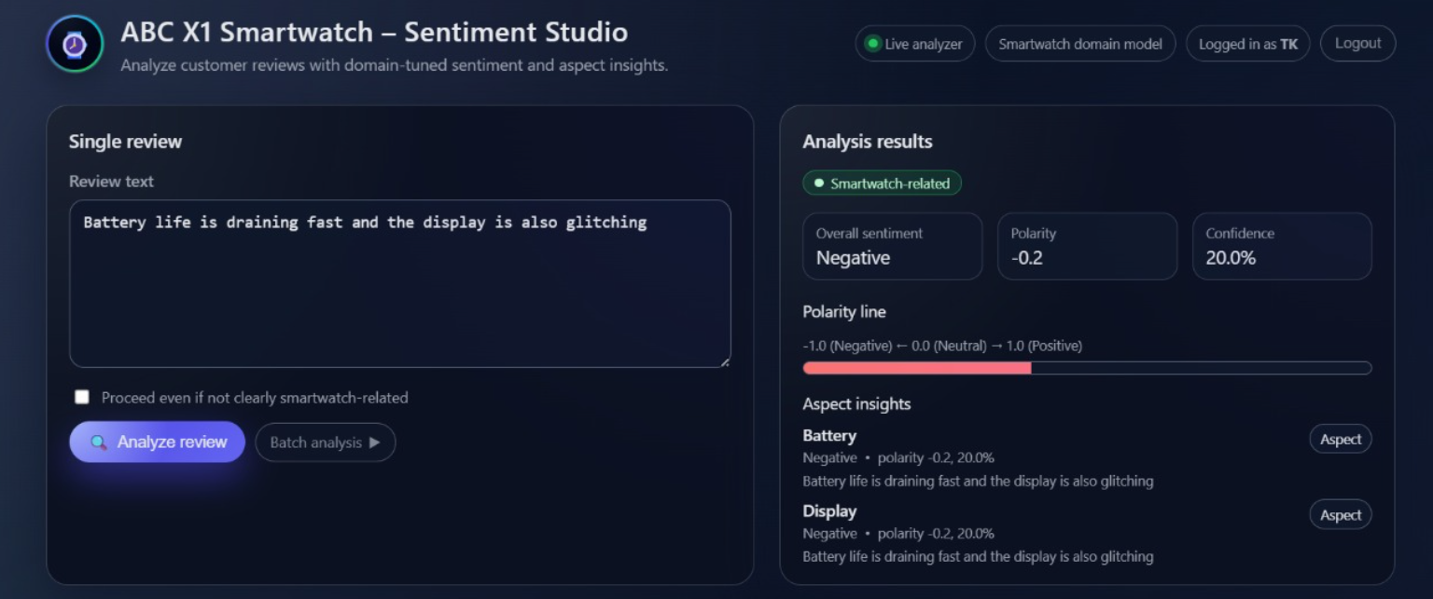
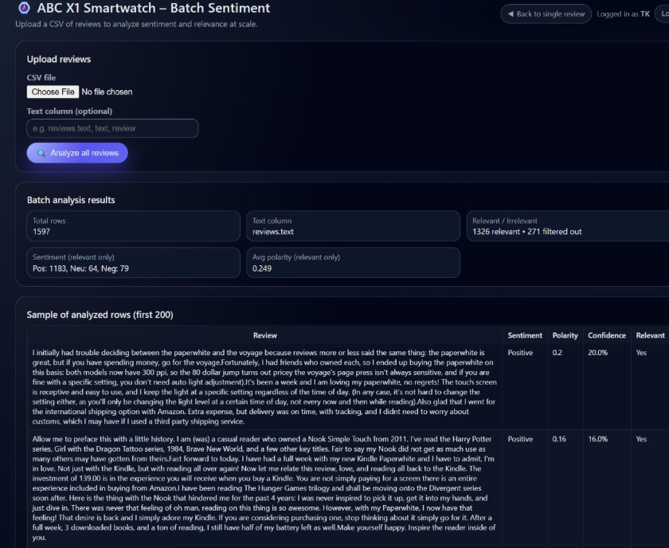
RESULTS & FINDINGS

Slide 8
CONCLUSION & FUTURE SCOPE
Conclusion:
The Smartwatch Sentiment Analyzer project successfully demonstrates how customer feedback can be transformed into meaningful insights using simple yet powerful tools. By combining Streamlit for an interactive interface and TextBlob for sentiment analysis, the system provides quick and accurate interpretations of customer reviews for the ABC X1 Smartwatch. This enables ABC Company to better understand user opinions, recognize strengths, and identify areas for improvement. Overall, the project highlights the value of sentiment analysis in guiding product enhancement, strengthening customer satisfaction, and supporting informed decision-making in future product development.
Future Scope:
Aspect-based sentiment analysis (battery, display, features)
Multi-language support expansion
Real-time dashboard for review monitoring
Integration with customer support systems
Mobile application deployment

